Slide 1

Mobile Application For Women Safety
Domain: Real Time
Android
Jayashree 111713104043
Jeevidha 111713104047
Keerthana 111713104052

Slide 2

INTRODUCTION
In earlier day’s the women have to dial a number to call a police or send a Short Messaging Service (SMS) to the particular subscriber code, after they received the service they will get in touch with u later. The basic and foremost aim of the projects is to develop a mobile app for women safety. Now a day’s the security of women is becoming very poor in all countries, we will develop a routine schedule based mechanism to monitor the women’s security using Global Positioning System(GPS), General packet radio service (GPRS),etc.

Slide 3

LITERATURE REVIEW
The previous work relay’s that the application developed to enhance the women security is very less in amount.. There are also so many volunteer organizations all over the world to help them, but they could not able to get those messages. The area which we choose is quite interesting and it ensure that our idea will get motivated and promoted as soon as possible.

Slide 4

PROBLEM DEFINITION
The main highlight of the project is how we are going to enhance the security of women with technology. We had chosen hand held device to provide security of the person via application using GPS, GPRS, etc., we also have many other sources to provide the security of the person but we thought that hand held device is one of the best idea to make the things work.

Slide 5
PROPOSED METHODOLOGY
METHOD OF IMPLEMENTATION(New Methodology)
We will be tracking the location of the person via GPS and storing the details of the current location in to a remote server via GPRS consecutively, we will also be tracking the schedule of the person as per the schedule list which is being uploaded by the person and we will be sending SMS to the relatives of the concerned person about the schedule their current location of the concerned person on that time. So that they will come to know about the status and if something is wrong we will be having another set of oppositions to give a call to a police, social workers, volunteer organizations, etc.

Slide 6
EXISTING METHODOLOGY
The previous work relay’s that the application developed to enhance the women security is very less in amount. The women have to dial a number to call a police or send a Short Messaging Service (SMS) to the particular subscriber code, after they received the service they will get in touch with u later. There are also so many volunteer organizations all over the world to help them, but they could not able to get those messages. The area which we choose is quite interesting and it ensure that our idea will get motivated and promoted as soon as possible.

Slide 7

ALGORITHM
Advanced Encryption Standard(AES).

Slide 8
MODULES
Time Schedule
Tracking
Notification

Slide 9
MODULE DESCREPTION
TIME SCHEDULE
When the apps get installed it traces out the IMEM, SIM, mobile number and stores in the remote server, the daily schedule list get uploaded by the person from his mobile and get tracked as per the schedule list, if there is any deviation in the schedule the relatives of the person will get an SMS along with the current location and the schedule and Police station members will get a call from the mobile.

Slide 10
MODULE DESCREPTION
TRACKING
Now a day’s the security of women is becoming very poor and the need for this kind of application is steadily increasing work wide, we will develop a routine schedule based mechanism to monitor the women’s security using Global Positioning System(GPS), General packet radio service (GPRS),etc. The GPS will regularly transmit the latitude and longitude of the person and via GPRS we will store the entire transmitted cloud server; if the person is lost we can trace the end location with this kind of approach.

Slide 11
MODULE DESCREPTION
NOTIFICATION
When the person is in trouble, when he presses an alarm in the application all his relatives, voluntary organization members, police men will get an SMS with his full contact details along with the current location from where the message has been delivered. Using the IMEM number the police men can track the location where they are travelling even if the mobile phone has got deactivated.

Slide 12
SYSTEM ARCHITECTURE
Mobile
Location
Cloud Server
Schedule
DB
Schedule Mismatch
Users
Parents

Slide 13
SYSTEM REQUIREMENT
HARDWARE REQUIREMENT
Processor - Pentium-IV
Speed - 1.1 Ghz
RAM - 512mb (min)
Hard Disk - 40GB
Key Board - Standard Windows
Mouse - Two or Three Button
Monitor - LCD/LED
Mobile -Android Mobile Handset

Slide 14
SYSTEM REQUIREMENT
SOFTWARE REQUIREMENT
Operating System - Android
Coding Language - Android
Data Base - MYSQL
Tool - ECLIPSE

Slide 15
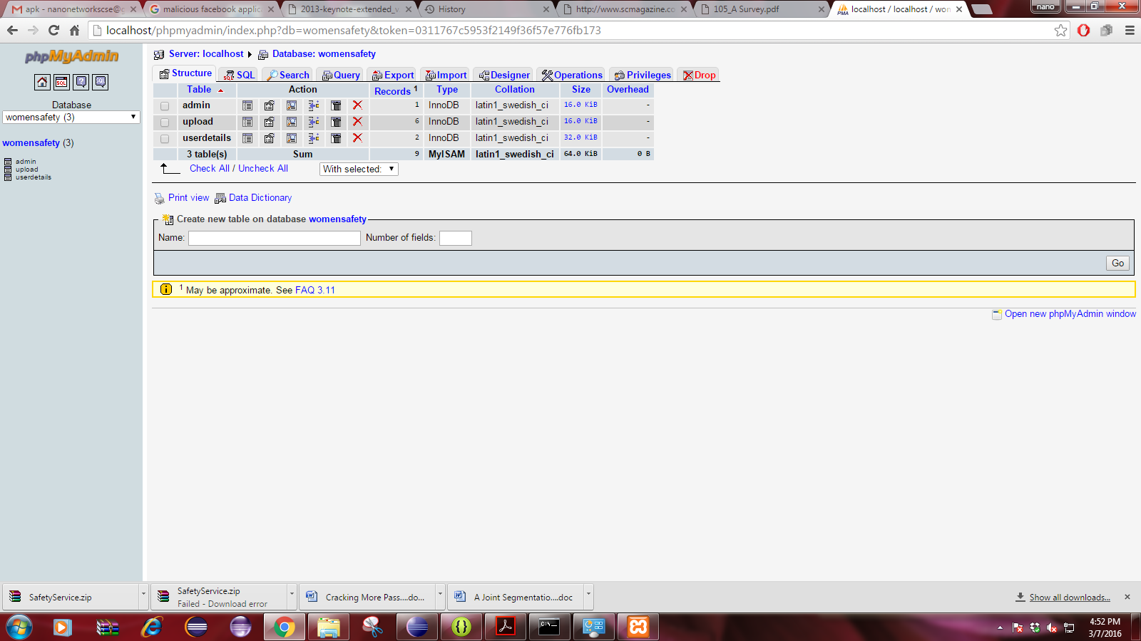

Slide 16
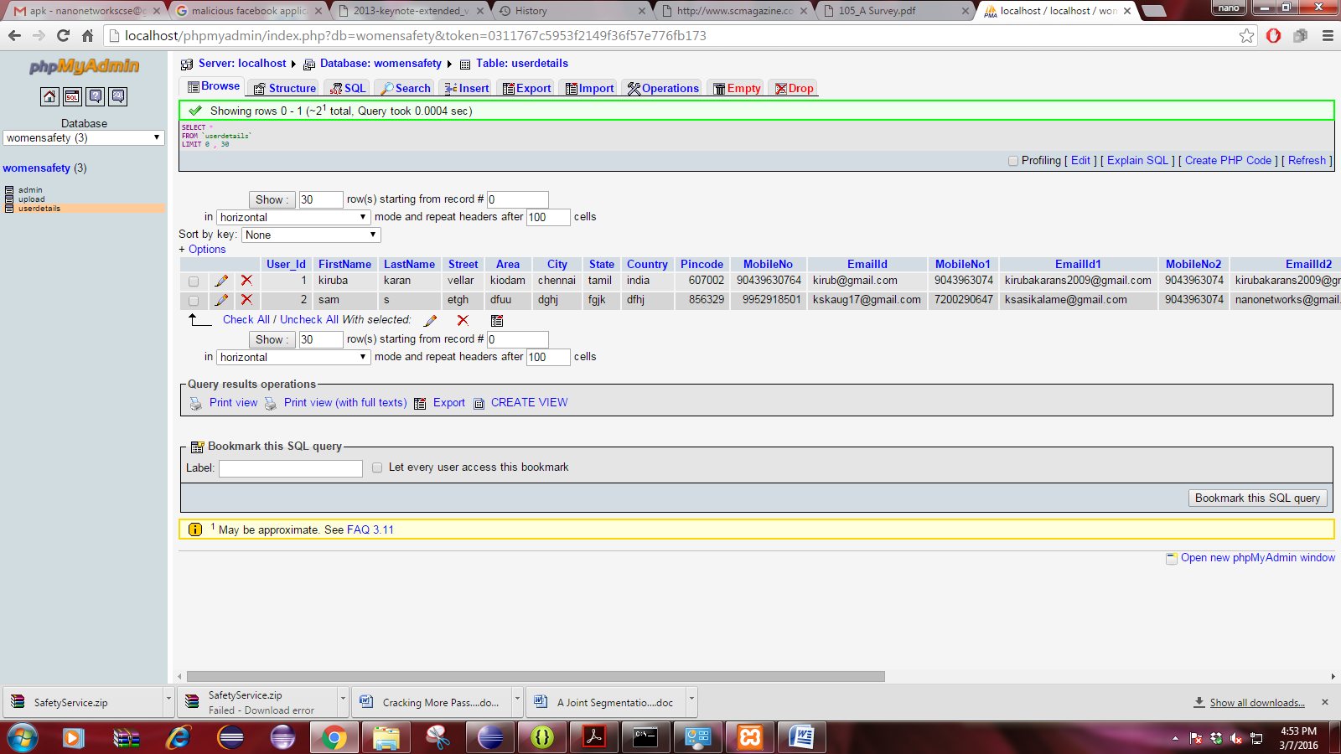

Slide 17
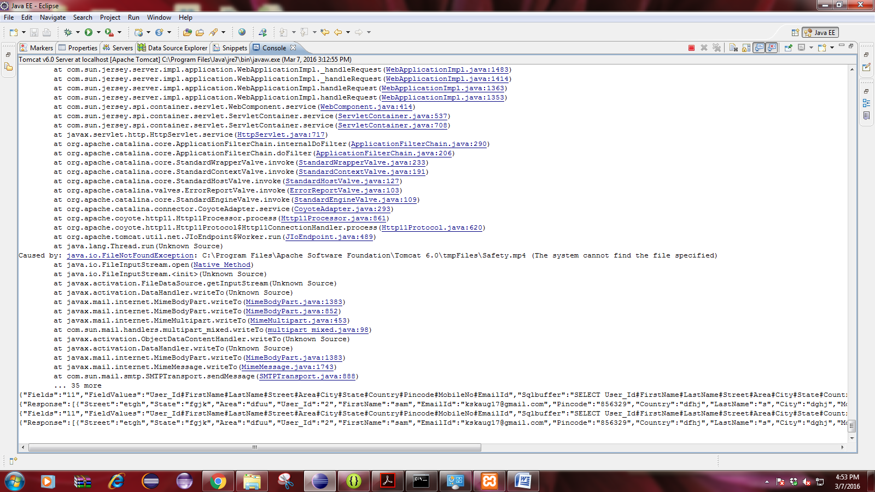

Slide 18
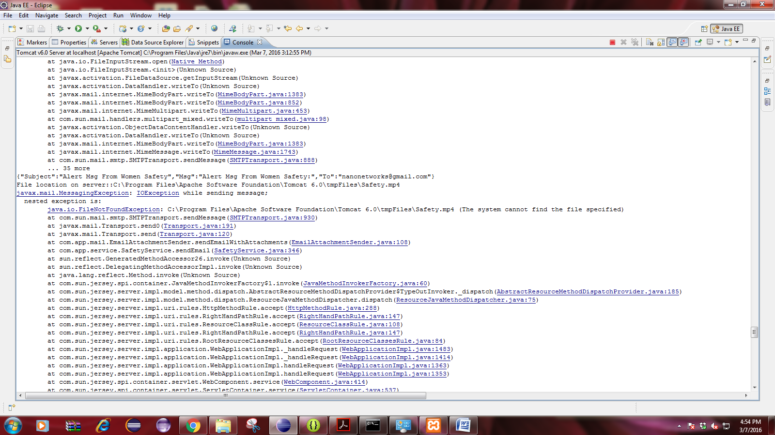

Slide 19
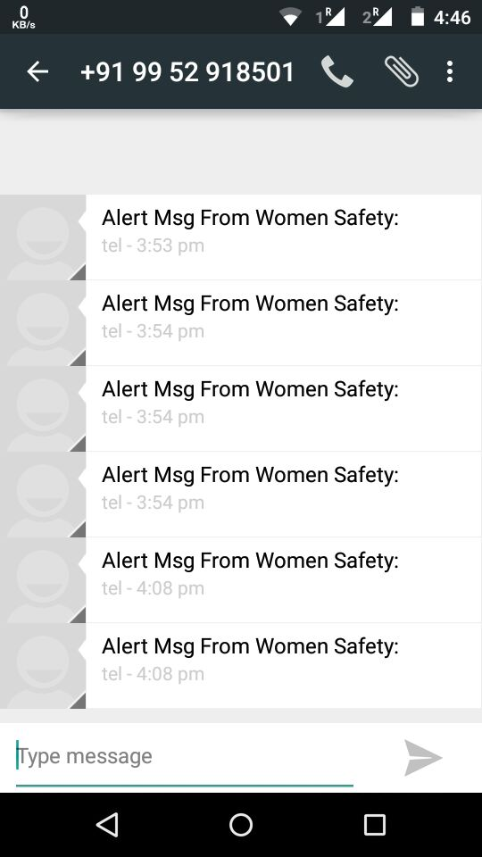

Allert message received

Slide 20
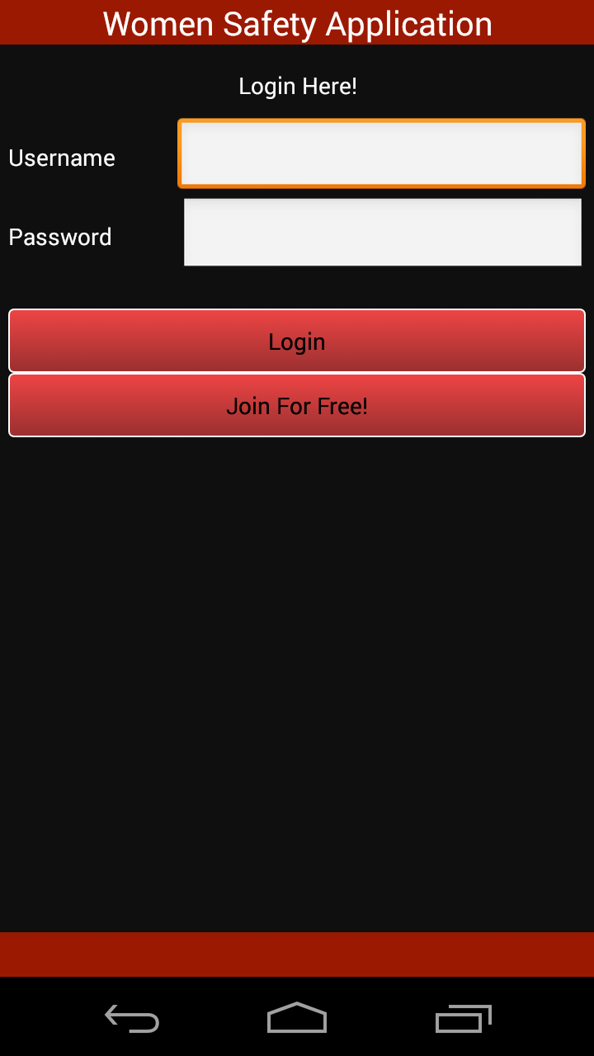
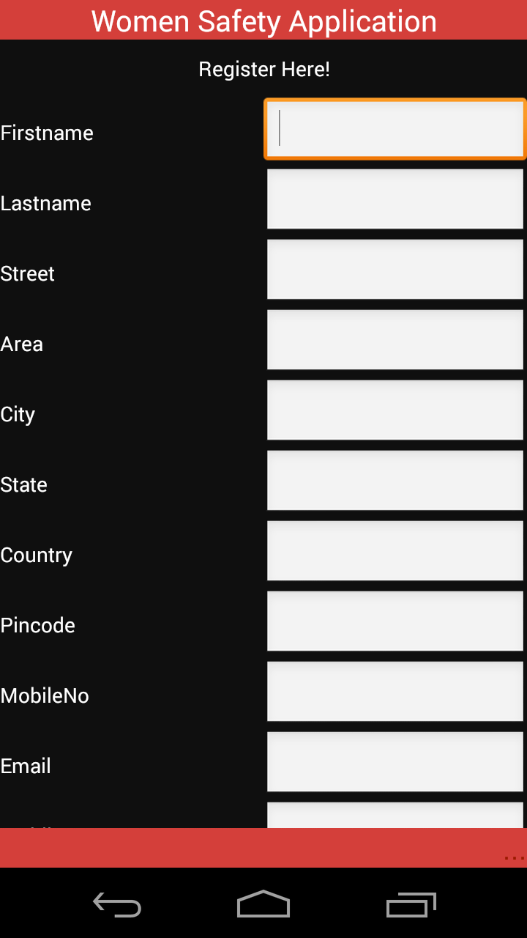

Slide 21
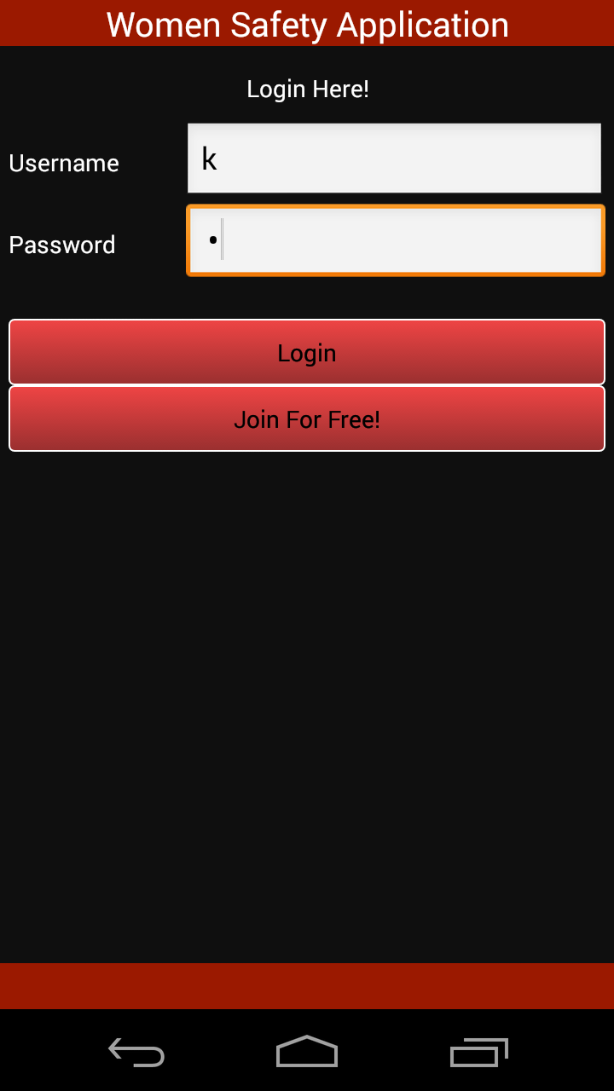
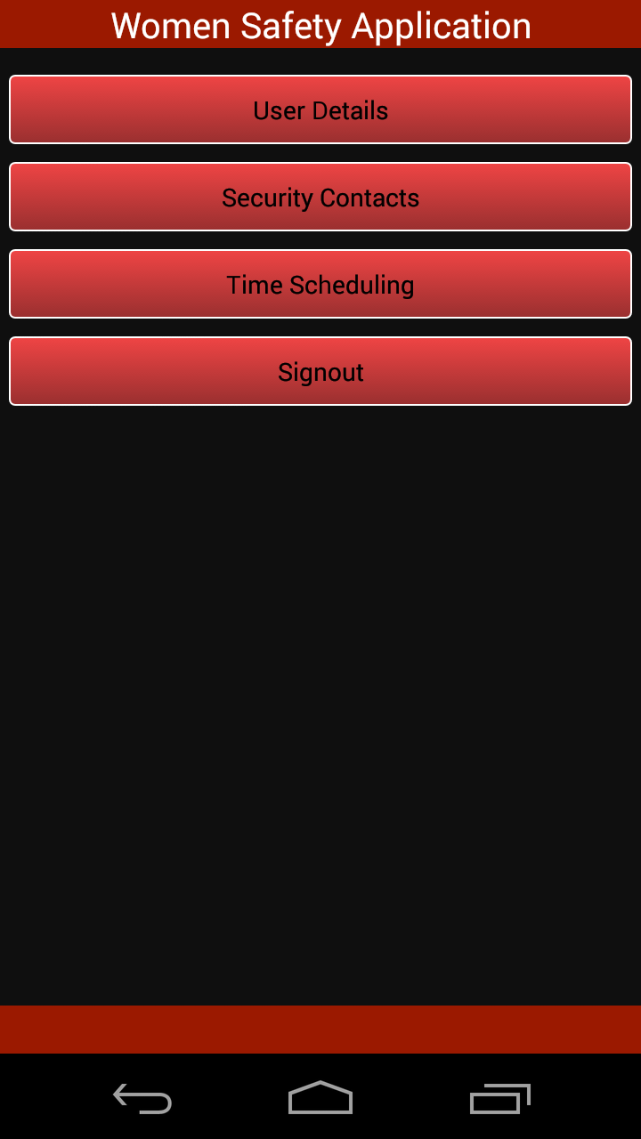

Slide 22
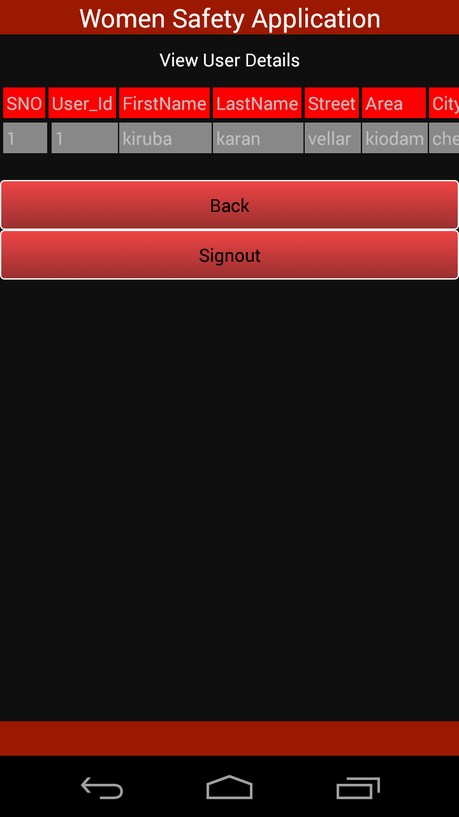
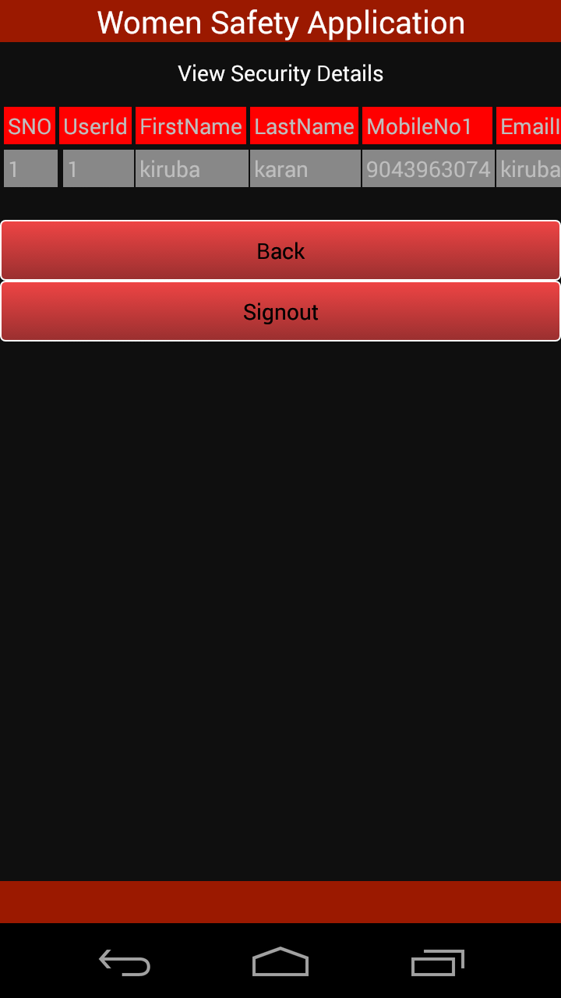

Slide 23
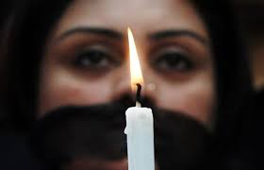
THANK YOU

